Slide 1
AI MINI PROJECT · CS23533 – FOUNDATIONS OF ARTIFICIAL INTELLIGENCE
AI-Based Smart Blood Donor–Recipient
Matching & Emergency Dispatch System
Rule-based reasoning, priority scheduling and A* search for faster, smarter emergency blood matching
PRESENTED BY
Rittvik S
Reg. No: 240701616
CS23533 – Foundations of Artificial Intelligence
1

Slide 2
+
Abstract
Timely access to a compatible blood donor is often the deciding factor in a medical emergency, yet most hospitals and blood banks still rely on manual phone-based donor search, which is slow and error-prone. This project proposes an AI-based Smart Blood Donor–Recipient Matching and Emergency Dispatch System built on classical AI techniques rather than manual coordination.
A rule-based expert system encodes ABO/Rh compatibility and eligibility rules (age, last donation gap, health status) to shortlist valid donors from a registered pool. Incoming requests are ranked by an urgency-priority module (Critical / Urgent / Routine), and an A* search algorithm computes the shortest route between the nearest eligible donor or blood bank and the requesting hospital on a city road-network graph.
By combining knowledge-based reasoning, priority scheduling and heuristic search, the system aims to cut emergency response time and give hospitals, blood banks and disaster-relief teams a faster, auditable way to locate and dispatch compatible donors.
CS23533 – Foundations of Artificial Intelligence
2

Slide 3
Literature Survey
Foundational algorithms and existing systems that shape this project
Work / Technique | Year | Key Contribution | Relevance to This Project
A* Search Algorithm (Hart, Nilsson & Raphael) | 1968 | Heuristic-guided optimal shortest-path search on a graph | Core of the Route Optimization module — donor/blood-bank to hospital
Dijkstra's Shortest-Path Algorithm | 1959 | Uninformed shortest-path computation, foundation of modern routing | Baseline used to benchmark A* routing efficiency
MYCIN Expert System (Shortliffe et al.) | 1976 | Rule-based (if-then) reasoning for clinical decision support | Model for the blood-compatibility rule engine
eRaktKosh — National Blood Bank portal (India) | Ongoing | Centralised donor and blood-stock registry across India | Shows the gap this project fills: no AI-based matching or routing
CSP-based resource allocation research | — | Constraint satisfaction for scheduling & matching problems | Informs eligibility filtering and priority-based donor selection
CS23533 – Foundations of Artificial Intelligence
3

Slide 4
System Architecture
End-to-end flow from an emergency request to donor dispatch
1
Hospital / User Request
Blood group, units needed, location & urgency entered
AI Techniques
Applied
2
Knowledge Base
Rule-based reasoning
Donor registry + ABO/Rh compatibility rule set
Priority queue scheduling
3
Compatibility Rule Engine
A* heuristic search
Forward-chaining expert system filters eligible donors
Weighted donor ranking
4
Priority Ranking Module
Classifies request as Critical / Urgent / Routine
5
A* Route Optimizer
Shortest path from donor/blood bank to hospital on city graph
6
Dispatch & Notification
Alerts donor & hospital with ranked matches and ETA
CS23533 – Foundations of Artificial Intelligence
4

Slide 5
System Modules
Seven modules working together, each built on a distinct AI concept
1
Donor & Recipient Database
2
Compatibility Rule Engine
3
Urgency Priority Module
Stores donor profiles (blood group, location, last donation date) and incoming recipient requests.
Forward-chaining rule-based expert system applies ABO/Rh compatibility & eligibility rules.
Scores each request Critical / Urgent / Routine and queues it by priority.
4
Route Optimization (A*)
5
Donor Ranking & Selection
6
Notification & Dispatch
Finds the shortest, most efficient path from donor or blood bank to the requesting hospital.
Weighted scoring on distance, availability and donation recency to rank eligible donors.
Auto-alerts the selected donor and hospital staff with route and estimated arrival time.
7
Admin Dashboard
Live map of requests and donors, plus analytics on response time and fulfilment rate.
CS23533 – Foundations of Artificial Intelligence
5

Slide 6
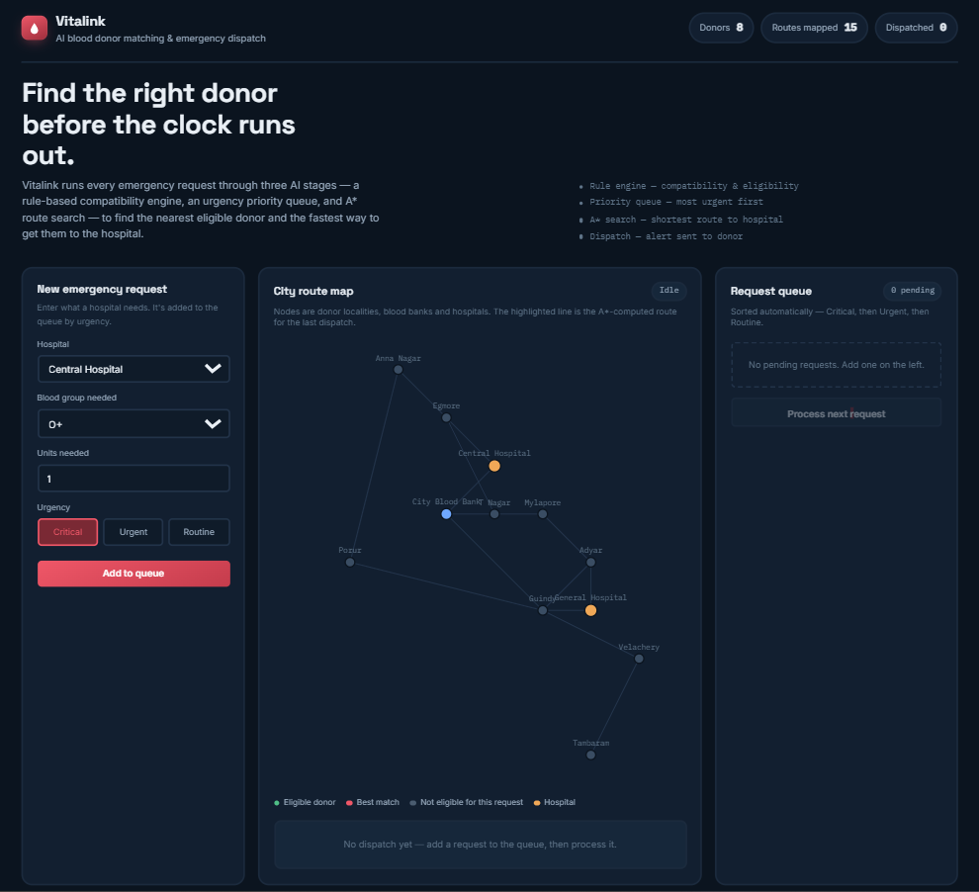
Expected Output
Live screenshot of the working Vitalink web app
The dashboard runs the full pipeline live: add a request, the rule engine filters donors, A* finds the fastest route, and the result is dispatched — all in the browser.
CS23533 – Foundations of Artificial Intelligence
6

Slide 7
Conclusion & Future Scope
Key Takeaways
Future Scope
Combines rule-based reasoning, priority scheduling and A* search to automate emergency blood-donor matching
Live traffic-API integration for real-time route re-optimization
Aims to cut manual search-and-call time, improving response during accidents, surgeries and disasters
Machine-learning-based demand forecasting for blood-stock planning
Gives hospitals and blood banks a single, auditable decision pipeline instead of ad-hoc phone coordination
Mobile app with donor opt-in/opt-out and gamified donation rewards
Thank You
Rittvik S · 240701616
CS23533 – Foundations of Artificial Intelligence
7

